Slide 1
SQL
QUERIES
Dr. Jose Annunziato

Slide 2
Agenda
Queries
Relational Algebra
SQL Queries
SQL Updates
Views
Chapter Summary
Suggested Reading
Exercises

Slide 3
SQL Queries
SQL stands for Structured Query Language
Many DB Systems don’t support whole standard
Use proprietary idioms that stray from standard
Relational algebra uses nested queries that feed their results through several operators
SQL queries are less verbose grouping several operators into sections called clauses
SELECT fields FROM tables WHERE predicates
select clause from clause

Slide 4
Basic SQL
SQL queries consist at least select and from clauses
The from clause specifies the data source table
The select clause specifies the data fields we want
The result of the query can be considered a table
Input Tables (from) Result Set
SQL Query

Slide 5
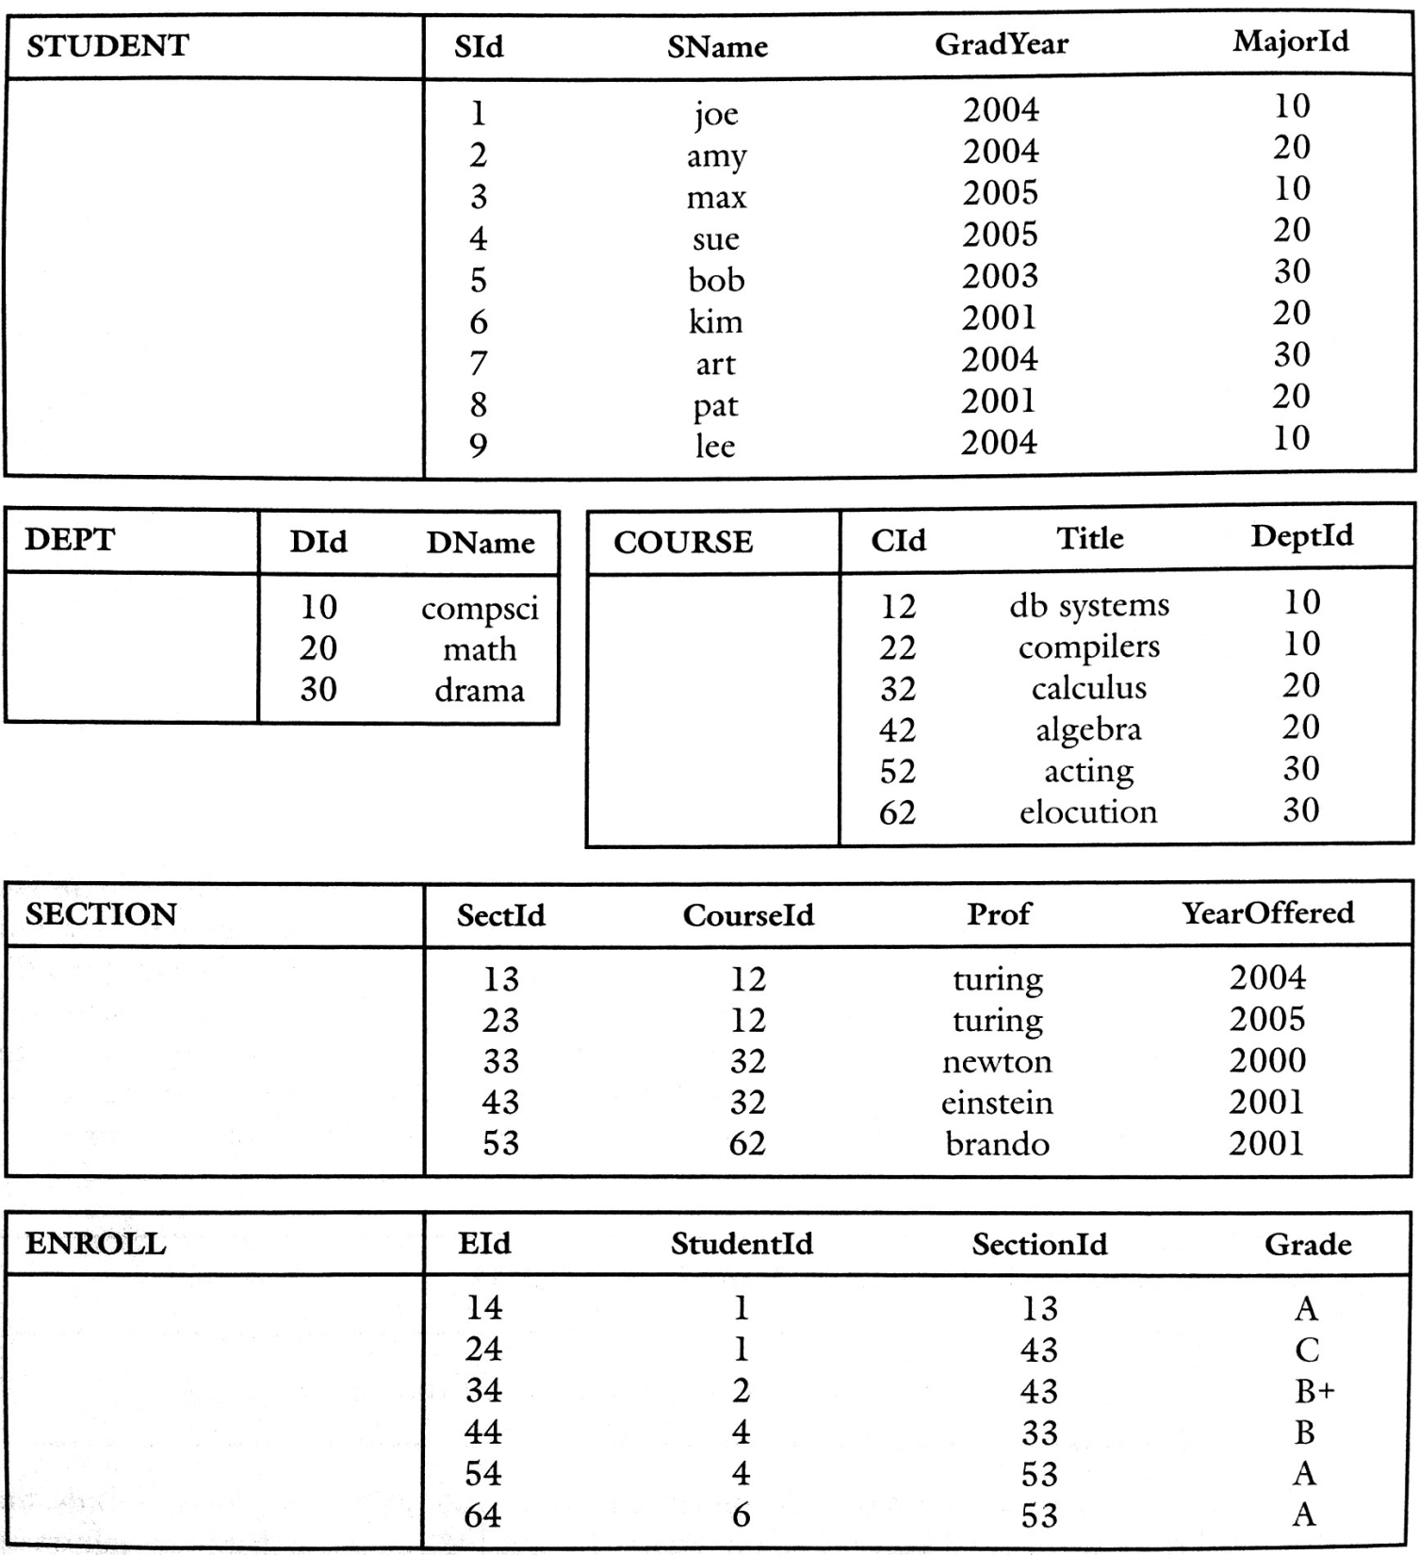

Slide 6
Recall the Student Database
Example, query retrieves names and graduation year of all students
select STUDENT.SName, STUDENT.GradYear
from STUDENT
from clause declares input table STUDENT
Fields prefixed by name of table STUDENT
Used to disambiguate when using many tables
Prefixes removed from result table

Slide 7
Range Variable
The prefix is called range variable
By default it’s the name of the table
The range variable name can be changed by providing a new name after the table, an alias
Here’s the same query with renamed range variable
select s.SName, s.GradYear
from STUDENT s
Useful for shorter names and self joins

Slide 8
Shorthand Notations
* means all fields of a table
t.* means all fields of table t
If no ambiguity don’t need table name
Removing the prefixes all together:
select SName, GradYear
from STUDENT

Slide 9
Example
Consider following tables
DEPARTMENT(id (pk), dname)
EMPLOYEE(name, did (fk))
Following fields are not ambiguous, so we don’t need the range variable
select name, dname
from DEPARTMENT, EMPLOYEE
where did = id
But if EMPLOYEE also had id field or if the dname field would have been name also, then need it

Slide 10
Persons Table Example
Consider following Persons table
SELECT * FROM Persons → returns whole table
The following select query returns just 2 fields
SELECT LastName, FirstName
FROM Persons
PId | LastName | FirstName | Address | City
1 | Wonder | Alice | Main 10 | Lowell
2 | Dole | Bob | Broad 23 | Lowell
3 | Garcia | Charlie | Mills 20 | Dracut
LastName | FirstName
Wonder | Alice
Dole | Bob
Garcia | Charlie

Slide 11
Select Distinct
Use DISTINCT keyword to return distinct values
SELECT DISTINCT column_name(s) FROM table_name
Without DISTINCT, we get repeated values
SELECT City FROM Persons
Distinct removes repeated values
SELECT DISTINCT City FROM Persons
City
Lowell
Lowell
Dracut
City
Lowell
Dracut

Slide 12
TYPES
Dr. Jose Annunziato

Slide 13
SQL Types and Built-In Functions
Table fields are of a certain type
SQL declares a set of standard data types
Field types declared when table is declared
Data types also define types of operations
Data types may differ from commercial databases
Consult the database’s manual
NUMERIC INTEGER or INT
SMALLINT FLOAT
DOUBLE VARCHAR

Slide 14
Function Library
SQL provides standard operators for arithmetic expressions
Vendors supply proprietary set of library functions, similar to other programming languages
Value truncated if destination scale too small
Error if precision is too small

Slide 15
Some Common SQL String Functions
lower (also, upper) – turn characters lower case (or upper case)
lower('Einstein') → 'einstein'
trim – remove leading and trailing spaces
trim(' Einstein ') → 'Einstein'
char_length – return number of characters in string
char_length('Einstein') → 8

Slide 16
Some Common SQL String Functions
substring – Extract a specified substring
substring('Einstein' from 2 for 3) → 'ins'
current_user – return the name of the current user
current_user → 'einstein'
|| – concatenate two strings
'A. ' || 'Einstein' → 'A. Einstein'
like – Match a string against a pattern
'Einstein' like '_i%i_%' → true

Slide 17
LIKE
Dr. Jose Annunziato

Slide 18
The Like Functions
'Einstein' like '_i%i_'
Like operator used to match a string to a pattern
Left side is a string: 'Einstein'
Right hand side is a pattern: '_i%i_'
Pattern contains special characters
'_' matches any single character
'%' matches any number of characters, including empty
So '_i%i_' matches: single char, letter i, any number of chars, letter i, single char
Other strings: 'iiii', 'xiixxx', 'xixxixixxx'

Slide 19
The Like Functions
Syntax
SELECT column_name(s) FROM table_name WHERE column_name LIKE pattern
Wildcards
Wildcard | Description
% | Substitute for zero or more characters
_ | Substitute for exactly one character
[charlist] | Any single character in charlist
[^charlist]or [!charlist] | Any single character not in charlist

Slide 20
Like Example
Consider the Persons table
SELECT * FROM Persons WHERE City LIKE 'lo%'
PId | LastName | FirstName | Address | City
1 | Boone | Dan | Main 10 | Lowell
2 | Dole | Bob | Broad 23 | Lowell
3 | Garcia | Charlie | Mills 20 | Dracut
PId | LastName | FirstName | Address | City
1 | Boone | Dan | Main 10 | Lowell
2 | Dole | Bob | Broad 23 | Lowell

Slide 21
DATES
Dr. Jose Annunziato

Slide 22
Date Types
DATE data type
Denotes year, month, day
Format: yyyy-mm-dd
Literal: DATE yyyy-mm-dd
Example: DATE '2008-08-04' → August 4, 2008
INTERVAL data type
Represents difference between dates
Example: INTERVAL '5' DAY

Slide 23
Common SQL Date/Interval Functions
current_date – return the current date
current_date → '2012-09-21‘
extract – extract the year, month, or day from a date.
extract(month, date '2008-07-04') → 7
+ add an interval to a date
date '2008-07-04' + interval '7' month → date '2009-02-04'
– subtract an interval to a date
date '2008-07-04' – date '2008-06-30' → interval '5' day

Slide 24
Date Formats
Some vendors differ representing Date and Time
MySQL: Format
DATE YYYY-MM-DD
DATETIME YYYY-MM-DD HH:MM:SS
TIMESTAMP YYYY-MM-DD HH:MM:SS
YEAR YYYY or YY
SQL Server: Format
DATE YYYY-MM-DD
DATETIME YYYY-MM-DD HH:MM:SS
SMALLDATETIME YYYY-MM-DD HH:MM:SS
TIMESTAMP a unique number

Slide 25
MySQL Date Functions
Function | Description
NOW() | Returns the current date and time
CURDATE() | Returns the current date
CURTIME() | Returns the current time
DATE() | Extracts the date part of a date or date/time expression
EXTRACT() | Returns a single part of a date/time
DATE_ADD() | Adds a specified time interval to a date
DATE_SUB() | Subtracts a specified time interval from a date
DATEDIFF() | Returns the number of days between two dates
DATE_FORMAT() | Displays date/time data in different formats

Slide 26
SQL Server Date Functions
Function | Description
GETDATE() | Returns the current date and time
DATEPART() | Returns a single part of a date/time
DATEADD() | Adds or subtracts a specified time interval from a date
DATEDIFF() | Returns the time between two dates
CONVERT() | Displays date/time data in different formats

Slide 27
Converting Dates
CONVERT ( type [ ( length ) ] , expression [ , style ] )
For dates, SQL Server has various enumerated styles
SELECT (GETDATE()) = 2007-06-06 23:41:10.153
SELECT CONVERT(varchar,GETDATE(),0) → Jun 6 2007
11:07PM
SELECT CONVERT(varchar,GETDATE(),1) → 06/06/07 SELECT CONVERT(varchar,GETDATE(),101) → 06/06/2007
SELECT CONVERT(varchar,GETDATE(),2) → 07.06.06 SELECT CONVERT(varchar,GETDATE(),102) → 2007.06.06

Slide 28
SELECT
Dr. Jose Annunziato

Slide 29
The Select Clause
The select clause can combine several operations
Calculating graduating class and college of each student:
select
s.*,
s.GradYear – 1863 AS GradClass,
'BC' AS College
from STUDENT s

Slide 30
Sample Output
Sid | SName | Major | GradClass | College
123 | Joe | Music | 153 | BC
124 | Alice | Music | 153 | BC
125 | Bob | Art | 154 | BC
126 | Charlie | Art | 154 | BC
127 | Daniel | Physics | 155 | BC
128 | Michael | Physics | 156 | BC

Slide 31
Example …
select
s.SId,
s.SName,
s.GradYear
from STUDENT s
Calculating a new ID and the graduation decade for each student

Slide 32
… Example …
select
s.SId AS NewSId,
s.SName,
s.GradYear AS GradDecade
from STUDENT s
Calculating a new ID and the graduation decade for each student

Slide 33
… String Concatenating Example …
select
'Student #' || s.SId AS NewSId,
s.SName,
s.GradYear AS GradDecade
from STUDENT s
Numeric values are converted to strings for concat

Slide 34
… Cast Example
select
'Student #' || s.SId AS NewSId,
s.SName,
cast(s.GradYear/10 as integer) * 10
AS GradDecade
from STUDENT s
Cast used to truncate division

Slide 35
Sample Result
NewSId SName GradDecade
Student #1 joe 2000
Student #2 amy 2000
Student #3 max 2000
Student #4 sue 2010
Student #5 bob 2010
Student #6 kim 2010
Student #7 art 2020
Student #8 pat 2020
Student #9 lee 2030

Slide 36
CASE
Dr. Jose Annunziato

Slide 37
Case Statements
Selected field values can be conditionally calculated
CASE WHEN condition THEN result
[WHEN ...]
[ELSE result]
END
Consider the test table containing field a with rows 1, 2, and 3
a
1
2
3

Slide 38
Case Example
The following query retrieves field a, and computes the case
SELECT a,
CASE WHEN a=1 THEN 'one'
WHEN a=2 THEN 'two'
ELSE 'other'
END
FROM test;
a | case
1 | one
2 | two
3 | other

Slide 39
Case, Another Syntax
If the test expression can evaluate to the same data type, then you can use a simpler syntax
CASE expression
WHEN value THEN result
[WHEN ...]
[ELSE result]
END

Slide 40
Case Example
SELECT a,
CASE a
WHEN 1 THEN 'one'
WHEN 2 THEN 'two'
ELSE 'other'
END
FROM test;

Slide 41
Arithmetic Expression Example
Calculating the number of years since graduation
Q69 = select s.*,
extract(YEAR, current_date) – s.GradYear AS AlumYrs
from STUDENT s
If current_date == '2011-4-23' then
extract(YEAR, current_date) → 2011
If GradYear == 2007 then
extract(YEAR, current_date) – s.GradYear = 2011–2007 = 4

Slide 42
Conditional Example
Q69 is a table that contains all the fields of STUDENT plus an additional column AlumnYrs
Column AlumnYrs has years since graduated
If not graduated, AlumYrs is negative <0
Determining whether a student has graduated
select q.*,
case when q.AlumYrs>0 then 'alumni'
else 'in school'
end AS GradStatus
from Q69 q

Slide 43
Equivalent If Expression
Vendors often provide proprietary equivalent if expression to standard case / else expression
Determining whether a student has graduated (nonstandard alternative version)
select q.*,
if(q.AlumYrs>0, 'alum', 'in school') AS GradStatus
from Q69 q

Slide 45
FROM
Dr. Jose Annunziato

Slide 46
The From Clause
The from clause specifies input tables
The following query returns all 27 combinations (3 x 9) of STUDENT and DEPT records
select s.*, d.*
from STUDENT s, DEPT d
The resulting table contains all 6 fields, 4 from STUDENT, and 2 from DEPT
We can use * since all field names are distinct
Otherwise use AS to distinguish

Slide 47
Disambiguating Fields
Use AS to disambiguate between fields with same name
Resulting table must have distinct field names
Following query returns all 81 (9 x 9) pairs of student names
select s1.SName AS Name1, s2.SName AS Name2
from EMPLOYEE s1, EMPLOYEE s2
Useful on self-joins (later)

Slide 48
Combining Tables with Join
Join operator combines tables that relate through keys
STUDENT.MajorId refers to DEPT.DId
The following query joins (combines) tables STUDENT and DEPT
select s.SName, d.DName
from STUDENT s join DEPT d on s.MajorId=d.Did
Returns student names and major departments

Slide 49
Join Syntax
There are several types of Joins, of which some are:
JOIN or INNER JOIN on NATURAL JOIN
LEFT JOIN or LEFT OUTER JOIN
RIGHT JOIN or RIGHT OUTER JOIN
FULL JOIN or FULL OUTER JOIN
The syntax for JOIN is
SELECT column_name(s) FROM table1 JOIN table2 ON table1.col1 = table2.col2
predicate

Slide 50
Inner Join Example
Consider the following tables Persons and Orders
FK Orders.PId references PK Persons.PId
PId | LastName | FirstName | Address | City
1 | Boone | Dan | Main 10 | Lowell
2 | Dole | Bob | Broad 23 | Lowell
3 | Garcia | Charlie | Mills 20 | Dracut
OId | OrderNo | PId
1 | 77895 | 3
2 | 44678 | 3
3 | 22456 | 1
4 | 24562 | 1
5 | 34764 | 15

Slide 51
Inner Join Example
The following query returns persons and their orders
SELECT p.LastName, p.FirstName, o.OrderNo FROM Persons p JOIN Orders o ON p.Pid = o.PId
LastName | FirstName | OrderNo
Boone | Dan | 22456
Boone | Dan | 24562
Garcia | Charlie | 77895
Garcia | Charlie | 44678

Slide 52
Left Join
Syntax
SELECT column_name(s) FROM table1 LEFT JOIN table2 ON table1.column_name=table2.column_name
Returns all rows from left table (table1), even if there are no matches in the right table (table2)
AKA LEFT OUTER JOIN

Slide 53
Recall Persons and Orders Table
PId | LastName | FirstName | Address | City
1 | Boone | Dan | Main 10 | Lowell
2 | Dole | Bob | Broad 23 | Lowell
3 | Garcia | Charlie | Mills 20 | Dracut
OId | OrderNo | PId
1 | 77895 | 3
2 | 44678 | 3
3 | 22456 | 1
4 | 24562 | 1
5 | 34764 | 15

Slide 54
Left Join Example
SELECT p.LastName, p.FirstName, o.OrderNo FROM Persons p LEFT JOIN Orders o ON p.PId = o.PId
LastName | FirstName | OrderNo
Boone | Dan | 22456
Boone | Dan | 24562
Garcia | Charlie | 77895
Garcia | Charlie | 44678
Dole | Bob

Slide 55
Why Outer Joins?
Consider the following tables:
STAFF(ssn, fname, lname)
SPOUSE(ssn, essn, fname, lname)
Where SPOUSE.essn refers to STAFF.ssn
Consider the following query:
"Find the name of each staff member and his/her spouse, if any"

Slide 56
Inner Join Is Not Enough
The following query only returns staff that have spouses
SELECT STAFF.fname, STAFF.lname,
SPOUSE.fname, SPOUSE.lname FROM STAFF INNER JOIN SPOUSE ON
STAFF.ssn=SPOUSE.essn

Slide 57
Need Outer Join
We also want the staff that do not have spouse
It's because of the "if any"
SELECT STAFF.fname, STAFF.lname,
SPOUSE.fname, SPOUSE.lname FROM STAFF LEFT JOIN SPOUSE ON
STAFF.ssn=SPOUSE.essn

Slide 58
Right Join
Syntax
SELECT column_name(s) FROM table1 RIGHT JOIN table2 ON table1.column_name=table2.column_name
Returns all rows from right table (table2), even if no matches in left table (table1)
AKA RIGHT OUTER JOIN

Slide 59
Recall Persons and Orders Table
PId | LastName | FirstName | Address | City
1 | Boone | Dan | Main 10 | Lowell
2 | Dole | Bob | Broad 23 | Lowell
3 | Garcia | Charlie | Mills 20 | Dracut
OId | OrderNo | PId
1 | 77895 | 3
2 | 44678 | 3
3 | 22456 | 1
4 | 24562 | 1
5 | 34764 | 15

Slide 60
Right Join Example
SELECT Persons.LastName, Persons.FirstName, Orders.OrderNo FROM Persons RIGHT JOIN Orders ON Persons.PId=Orders.PId
LastName | FirstName | OrderNo
Boone | Dan | 22456
Boone | Dan | 24562
Garcia | Charlie | 77895
Garcia | Charlie | 44678
 |  | 34764

Slide 61
Full Join
SELECT column_name(s) FROM table1 FULL JOIN table2 ON table1.column_name=table2.column_name
FULL JOIN return rows when there is a match in either of the tables.

Slide 62
Recall Persons and Orders Table
PId | LastName | FirstName | Address | City
1 | Boone | Dan | Main 10 | Lowell
2 | Dole | Bob | Broad 23 | Lowell
3 | Garcia | Charlie | Mills 20 | Dracut
OId | OrderNo | PId
1 | 77895 | 3
2 | 44678 | 3
3 | 22456 | 1
4 | 24562 | 1
5 | 34764 | 15

Slide 63
Full Join Example
SELECT Persons.LastName, Persons.FirstName, Orders.OrderNo FROM Persons FULL JOIN Orders ON Persons.PId=Orders.PId
LastName | FirstName | OrderNo
Boone | Dan | 22456
Boone | Dan | 24562
Garcia | Charlie | 77895
Garcia | Charlie | 44678
Dole | Bob
 |  | 34764

Slide 64
Specifying Several Joins
Use parentheses to group matching records
The names of students and their professors (less readable version)
select s.SName, k.Prof
from (STUDENT s join ENROLL e on s.SId=e.StudentId)
join SECTION k on e.SectionId=k.SectId

Slide 65
Explicit & Implicit Notation
Explicit Join Notation uses JOIN … ON
SELECT * FROM employee
INNER JOIN department ON
employee.DepartmentID =
department.DepartmentID;
Implicit Join Notation uses FROM … WHERE
SELECT * FROM employee, department
WHERE employee.DepartmentID =
department.DepartmentID;
predicates

Slide 66
WHERE
Dr. Jose Annunziato

Slide 67
The Where Clause
Use the where clause to list predicates
Only records that fulfill the predicates are returned
Syntax
SELECT column_name(s)
FROM table_name
WHERE column_name operator value

Slide 68
Predicate Operators
The following are valid operators in the predicates
Combine several predicates with AND and OR
Operator | Description
= | Equal, not double equal (==)
<> | Not equal, not bang equal (!=)
> | Greater than
< | Less than
>= | Greater than or equal
<= | Less than or equal
BETWEEN | Between an inclusive range
LIKE | Search for a pattern
IN | Specify multiple values for a column

Slide 69
Where Example
Consider the Persons table
The following query returns only records that match
SELECT * FROM Persons WHERE City='Lowell'
PId | LastName | FirstName | Address | City
1 | Boone | Dan | Main 10 | Lowell
2 | Dole | Bob | Broad 23 | Lowell
3 | Garcia | Charlie | Mills 20 | Dracut
PId | LastName | FirstName | Address | City
1 | Boone | Dan | Main 10 | Lowell
2 | Dole | Bob | Broad 23 | Lowell

Slide 70
AND Example
Consider the Persons table
SELECT * FROM Persons WHERE FirstName='Bob' AND LastName='Dole'
PId | LastName | FirstName | Address | City
1 | Boone | Dan | Main 10 | Lowell
2 | Dole | Bob | Broad 23 | Lowell
3 | Garcia | Charlie | Mills 20 | Dracut
PId | LastName | FirstName | Address | City
2 | Dole | Bob | Broad 23 | Lowell

Slide 71
OR Example
Consider the Persons table
SELECT * FROM Persons WHERE FirstName='Bob' OR FirstName='Dan'
PId | LastName | FirstName | Address | City
1 | Boone | Dan | Main 10 | Lowell
2 | Dole | Bob | Broad 23 | Lowell
3 | Garcia | Charlie | Mills 20 | Dracut
PId | LastName | FirstName | Address | City
1 | Boone | Dan | Main 10 | Lowell
2 | Dole | Bob | Broad 23 | Lowell

Slide 72
Combining AND and OR
Consider the Persons table
SELECT * FROM Persons WHERE LastName='Dole' AND (FirstName='Bob' OR FirstName='Dan')
PId | LastName | FirstName | Address | City
1 | Boone | Dan | Main 10 | Lowell
2 | Dole | Bob | Broad 23 | Lowell
3 | Garcia | Charlie | Mills 20 | Dracut
PId | LastName | FirstName | Address | City
2 | Dole | Bob | Broad 23 | Lowell

Slide 73
Multiple Joins with Where
Multiple joins are awkward in the from clause
Syntax easier in where clause
Where clause is optional
Evaluated after from, but before select
Following query returns names of students graduating in 2005 or 2006
select s.SName
from STUDENT s
where (s.GradYear=2005) or (s.GradYear=2006)

Slide 74
Multiple Joins with Where
The multiple joins example from earlier:
select s.SName, k.Prof
from (STUDENT s join ENROLL e on s.SId=e.StudentId)
join SECTION k on e.SectionId=k.SectId
More readable using where clause
select s.SName, k.Prof
from STUDENT s, ENROLL e, SECTION k
where s.SId=e.StudentId and e.SectionId=k.SectId

Slide 75
Joins and Selection Predicates
Where clause allows combining selection and join predicates
Here's an example set of selections and joins to retrieve the grades Joe received during his graduation year
select e.Grade
from STUDENT s, ENROLL e, SECTION k
where s.SId=e.StudentId and e.SectionId=k.SectId
and s.SName='joe' and k.YearOffered=s.GradYear

Slide 76
Between Example
SELECT column_name(s) FROM table_name WHERE column_name BETWEEN value1 AND value2
BETWEEN operator used in WHERE clause to select range of data between two values

Slide 77
Between Example
Consider the Persons table
SELECT * FROM Persons WHERE LastName BETWEEN 'Boone' AND 'Garcia'
PId | LastName | FirstName | Address | City
1 | Boone | Dan | Main 10 | Lowell
2 | Dole | Bob | Broad 23 | Lowell
3 | Garcia | Charlie | Mills 20 | Dracut
PId | LastName | FirstName | Address | City
1 | Boone | Dan | Main 10 | Lowell

Slide 78
Not Between Example
SELECT * FROM Persons WHERE LastName NOT BETWEEN 'Boone' AND 'Garcia'
P_Id | LastName | FirstName | Address | City
2 | Dole | Bob | Broad 23 | Lowell
3 | Garcia | Charlie | Mills 20 | Dracut

Slide 79
In Keyword
SELECT column_name(s) FROM table_name WHERE column_name IN (value1,value2,...)
IN operator allows specifying multiple values WHERE clause

Slide 80
In Example
Consider the Persons table
SELECT * FROM Persons WHERE LastName IN ('Boone','Garcia')
PId | LastName | FirstName | Address | City
1 | Boone | Dan | Main 10 | Lowell
2 | Dole | Bob | Broad 23 | Lowell
3 | Garcia | Charlie | Mills 20 | Dracut
PId | LastName | FirstName | Address | City
1 | Boone | Dan | Main 10 | Lowell
3 | Garcia | Charlie | Mills 20 | Dracut

Slide 81
Built-In Functions in Where Clause
Functions and operators such as arithmetic expressions, like, and extract can appear in the where clause
Here's an example query returning the students whose names begin with 'j' and graduate this year
select s.*
from STUDENT s
where s.SName like 'j%'
and s.GradYear = extract(YEAR, current_date)

Slide 82
current_user Example
If the SECTION.prof (proferssor's name) is the same as the DB's login name…
Following query returns grades given by current logged in professor
select s.SName, e.Grade
from STUDENT s, ENROLL e, SECTION k
where s.SId = e.StudentId
and e.SectionId = k.SectId
and k.Prof = current_user

Slide 83
Equivalent Relational Algebra
Q60 = rename(STUDENT, SName, STUDENT.SName)
Q61 = rename(Q60, GradYear, STUDENT.GradYear)
Q62 = project(Q61, {STUDENT.SName, STUDENT.GradYear})
Q63 = rename(Q62, STUDENT.SName, SName)
Q64 = rename(Q63, STUDENT.GradYear, GradYear)

